Slide 1
Task Management System
EE-553 Engineering Programming: C++
ISMET OKAN CELIK

Slide 2
Introduction
The main idea behind this project is to make it easier to follow the progress of a given task, priority level, expected deadline, and task definition inside the project team.
The most important feature of the system is that everyone can see which person is performing which task and, what is the expected deadline, what is the priority level if anybody has more than one task to complete.
It makes easier to manage a project team.

Slide 3
Introduction
Project was mainly designed around 4 different pages.
Team manager has access to all these pages, but team members only can access Show Task Tracking.
The reason is we only want the team members to update their status about the project, and this page allows them to do so.

Slide 4
Add New Employee
This section will allow a manager to add a new team member to the system.
When we enter this page, the system asks whether we want to add a new employee to the system or not depending on the answer if we say yes as “y”, the system continues to ask us to enter a name, last name and title in order to add a new employee to the system. If we would answer the question as no “n”, system will direct us to the main page.

Slide 5
List Employee Records
This section shows the employees the system with their titles. It allows us to check who the project team members are and what their specialties are. If desired, the system allows the user to go back to the main menu by pressing the ESC button on the keyboard.

Slide 6
Assign Task
This menu is where managers come to assign a task to team members.
The manager needs to pick a person from the list and answer the following questions. One of the essential parts of this section is that the program automatically takes the local date when assignments are assigned, calculates the deadline automatically with the entered number of days, and shows the exact expected deadline in the Show Task Tracking section.

Slide 7
Show Task Tracking
This section shows the priority level, status, deadline, and task description. The priority level is between 0-5. Status shows how many percentages of this given task are completed. Only a team member can update the status of the given task.
Team manager can extend the deadline of the given task from this page or delete task from list.

Slide 8
Show Task Tracking (Admin)
If the manager wants the delete a task from the given list, answer the first question as DELETE by pressing the “d” button from the keyboard, after that needs to choose TaskId from the list.
For example, one of the tasks is completed and the status of the task is 100%. It’s better to delete this record to keep the chart as simple as possible.

Slide 9
Show Task Tracking (Admin)
If the manager wants the extend the deadline for one of the tasks, answer the first question as UPDATE by pressing the “u” button from keyboard, after that needs to pick a TaskId from the list. Lastly, the person needs to enter the number of days to extend the deadline.

Slide 10
Show Task Tracking (Admin)
If we press ESC button to go back main menu and come back to Show Task Tracking page, as we can see on the picture that deadline will be updated.

Slide 11
Show Task Tracking (User)
Employees only allow to update the status of the task. If they want to update their status, they need to answer the first question as yes by pressing “y” on keyboard after that, need to enter the percentage the completed for given task

Slide 12
Show Task Tracking (User)
If we press the ESC button to go back to the main menu and come back to the Show Task Tracking page, as we can see in the picture the deadline will be updated.

Slide 13
Show Task Tracking (User)
If the users complete the task, then they can update their status as 100%, then the system will update itself as “100% Completed” instead of “InProgress”.

Slide 14

Demonstration of Project

Slide 15
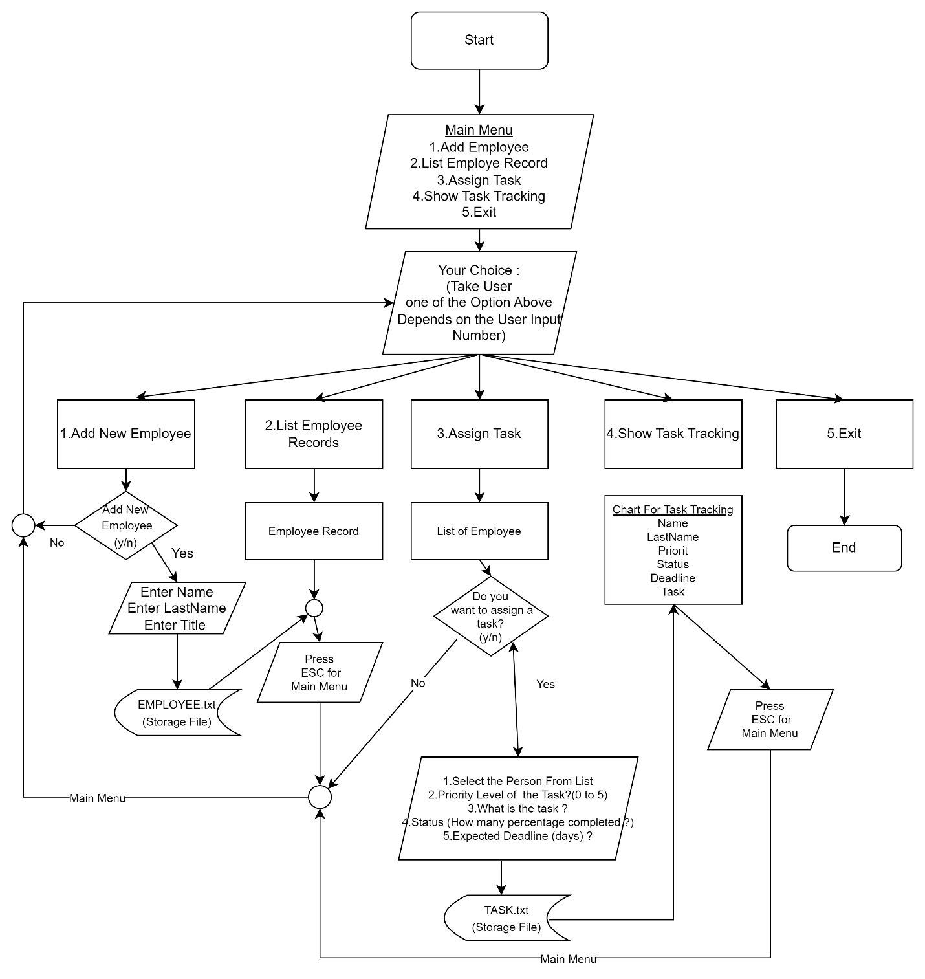
Summary

Slide 16
Development Ideas – Future Works
Developing an appropriate login system for the users. Every user will be able to login into the system with their personalized password.
Adding Request system. This will help users to put messages about projects or request messages regarding tasks.

